Slide 1

One Data Format To Rule Them All
Alexander Niculescu DATA 607
Tips & Hints on the wonderful world of data engineering

Slide 2
Popular Formats
Flattened
Nested
Compressions
Parquet
Json
gzip
ORC
Bson
snappy
csv
Avro
lz4
XML

Slide 3
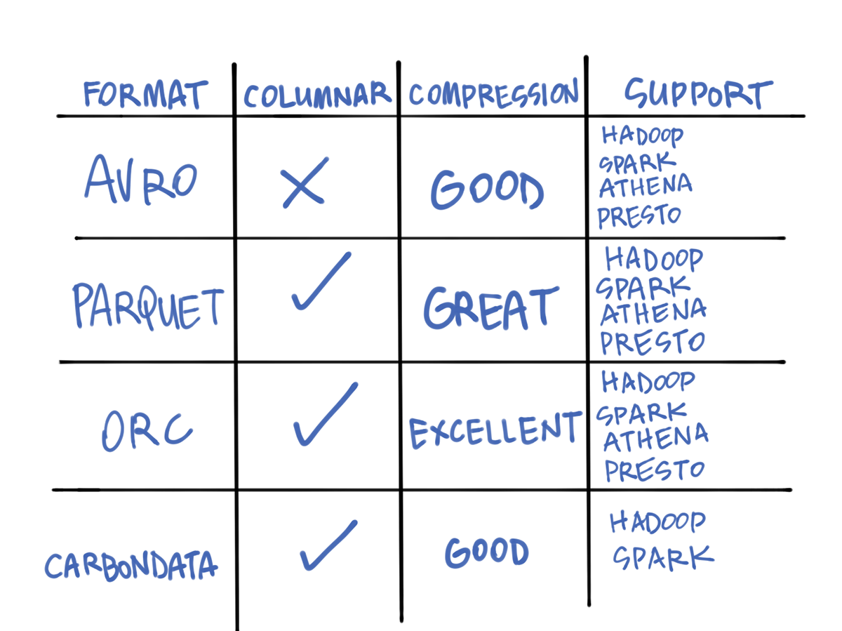
Project objective
*Hive metadata support too

Slide 4
Prerequisites to Seamless Data Work
Heavy joins and queries
Multi Cloud Environment
1
3
2
Read or Write and storage size
Ram VS Disk
4
Building a metadata catalogue / search engine

Slide 5

To Flatten or not to Flatten GCP
Clickstream data is an integral part of many businesses. Certain tables have incremental pieces of data, which need to be decoupled and pulled out of json. The reason is json takes up alot of space.

Slide 6
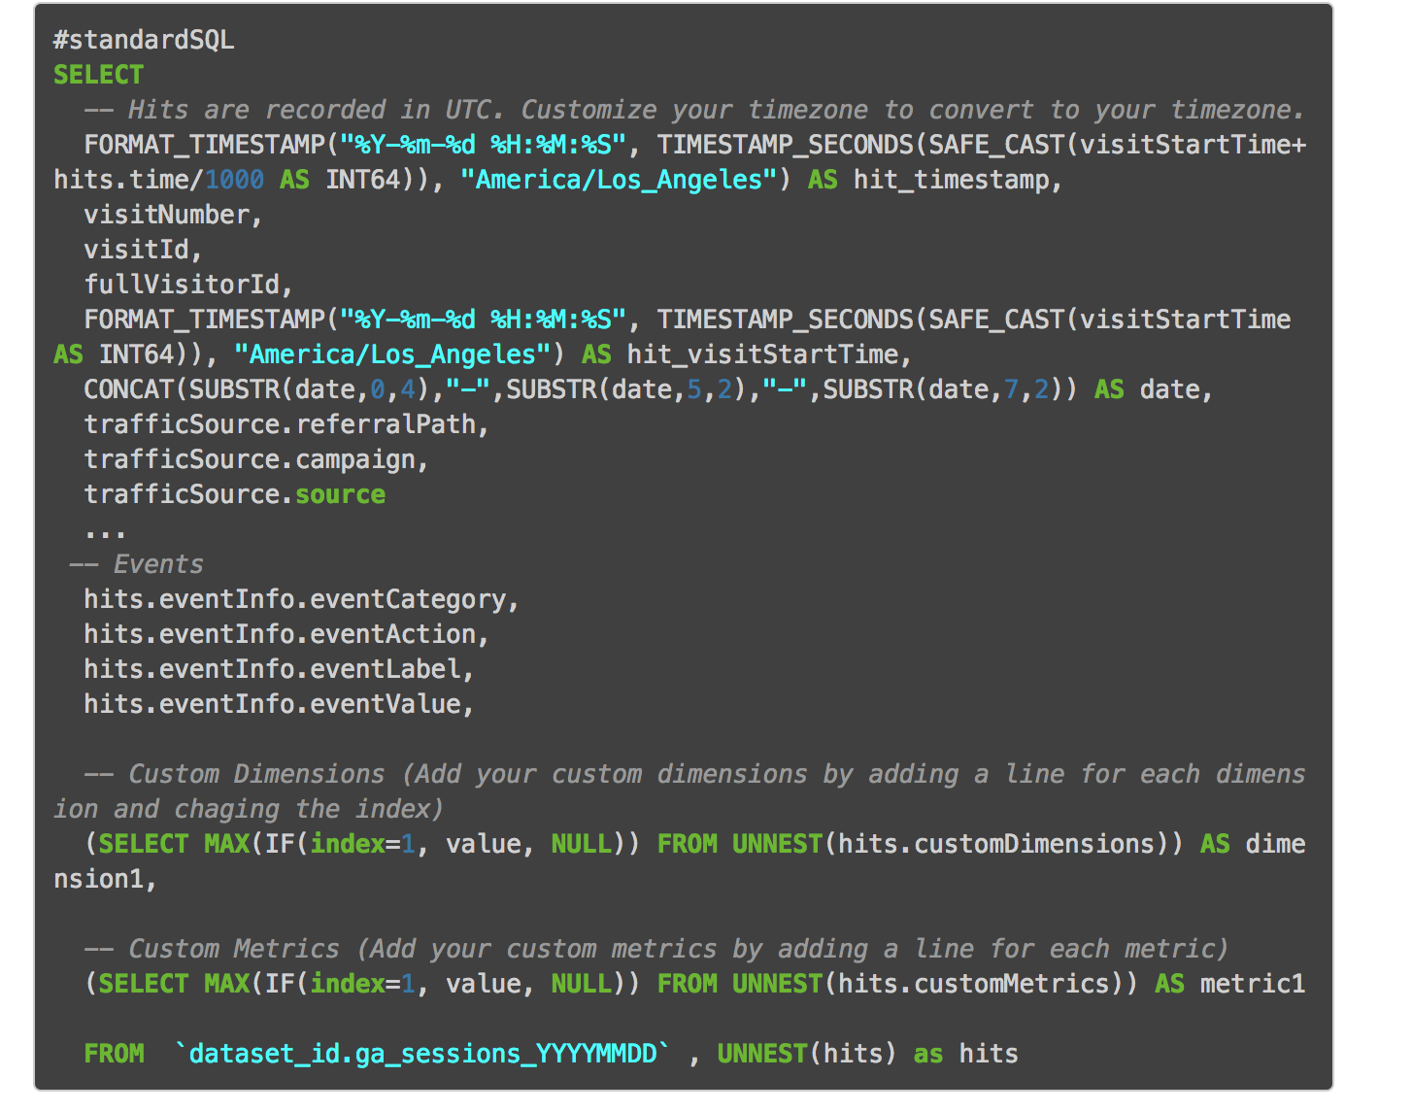


Good Ol’ Big Query
Note:
You can also select * From hits.eventInfo.*
QUICK TIP
Try right clicking on a photo and using "Replace Image" to show your own photo.

Slide 7
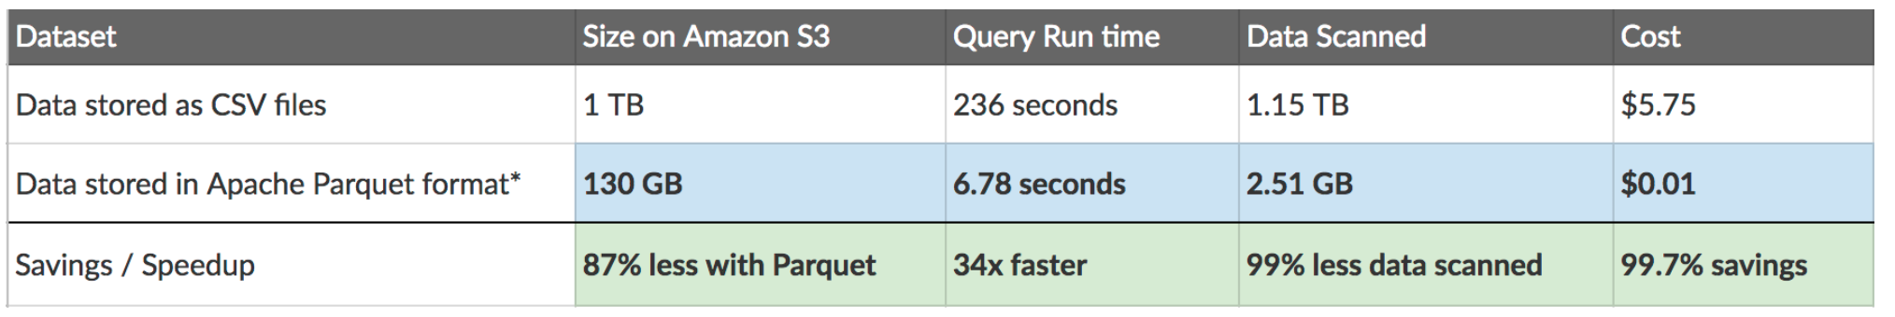
Sample Business Comparison

Slide 8
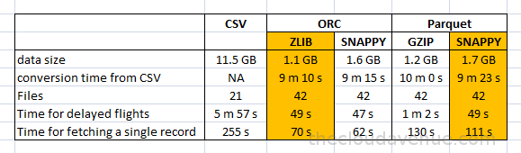
This example was based on the complete flights table. Below are comparisons for csv, orc, and parquet.
5%
Incididunt ut labore et dolore sed do eiusmod tempor incididunt ut labore et dolore magna aliqua.
Trend 02
Tempor incididunt labore et dolre sed do eiusmod tempor incididunt ut labore et dolore magna aliqua.

Slide 9


Going Columnar
01 | Only Columns in Use are loaded
02 | Great for on-the-fly calculations
03 | Lean Joins
04 | Greap compression
05 | Doesn’t store repeated values

Slide 10
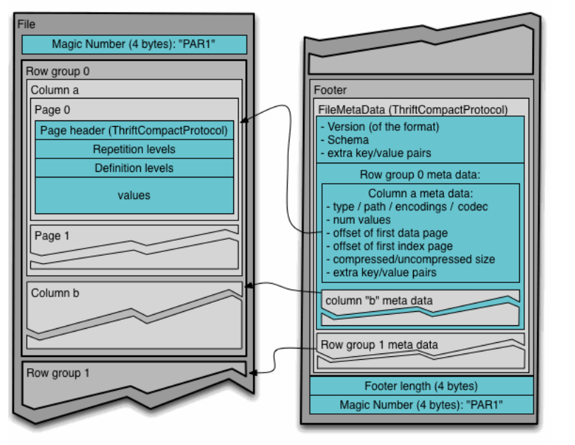
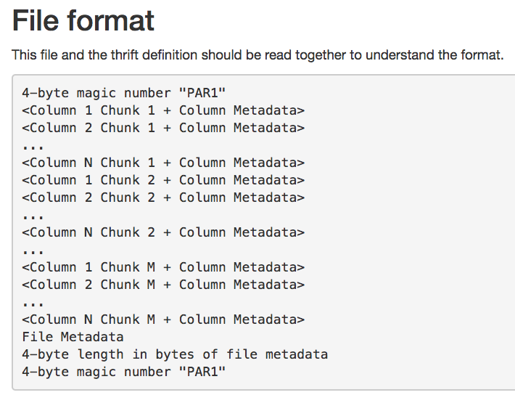
Parquet Deep Dive

Slide 11
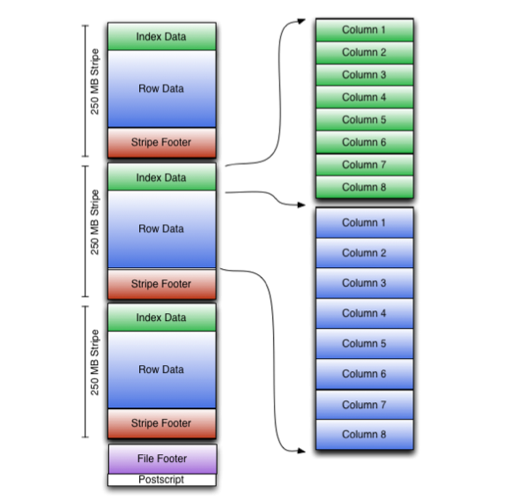
ORC vs Parquet

Slide 12
Proposed solution
Use ORC as often as possible
*the exception is if it is a heavy spark shop, then please keep everything in parquet

Slide 13

ORC
ORC is well supported by AWS, databricks, HortonWorks, and Cloudera
90%
500x
78%
Smaller than a csv
Faster queries
Compression from a text file
Notes:
From text is where it shines compared to Parquet

Slide 14
Sources Cited
If you want to try some fun home, turn csv’s into Parquets and Orc files using the sparklyr package
Photos all courtesy of google images
https://www.jowanza.com/blog/which-hadoop-file-format-should-i-use

